Slide 1
ICAS: an Extensive Framework for Estimating the Susceptibility of IC Layout to Additive Trojans
Timothy Trippel, University of Michigan
Kang G. Shin, University of Michigan
Kevin B. Bush, MIT Lincoln Laboratory
Matthew Hicks, Virginia Tech
Notes:
密西根大學
麻省理工林肯實驗室
維吉尼亞理工大學

Slide 2
Outline
Abstract
Background
Two IC Defensive Approach
ICAS Attack Step
ICAS Framework
Evaluation
Discussion
Conclusion

Slide 3
Outline
Abstract
Background
Two IC Defensive Approach
ICAS Attack Step
ICAS Framework
Evaluation
Discussion
Conclusion

Slide 4
Abstract
transistor的dimension隨著製程的進步愈來愈小，在提升performance以及density的同時，同樣也降低的可信度(trust)。可信度的降低是因為black box nature of fabricated IC。因此我們必須也要保護我們的physical design。
這篇paper提出了一個IC Attack Surface (ICAS)的extensive IC layout security analysis tool。ICAS會藉由考慮各種插入trojan的方式來評估這個physical design是否安全。 他的ideal score為0，分數愈低代表會需要花費更多的精力來攻擊這個design。

Slide 5
Outline
Abstract
Background
Two IC Defensive Approach
ICAS Attack Step
ICAS Framework
Evaluation
Discussion
Conclusion

Slide 6
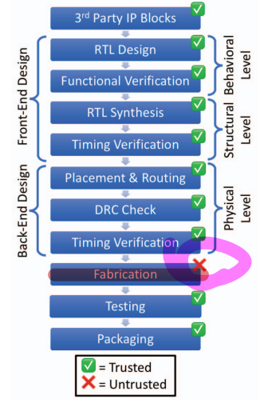
Background : IC Design Process
由右圖可以看到，在fab製造的過程中，可能會對我們的physical design model產生威脅。
IC layout的bottom layer是device layer : 放置circuit component的
IC layout的top layer是metal layer : 用來繞線的

Slide 7
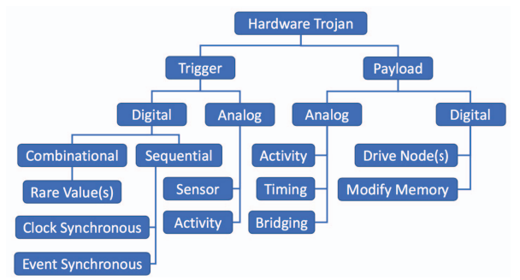
Background : Hardware Trojan
Consist of:
留言
(1) payload : the malfunction
design of the IC
(2) trigger : to activate the
payload

Slide 8
Background : Trojan Prevention
Increasing placement & routing resource utilization (更少地方可以implement他們的trojan design)
留言
Increasing congestion around security-critical design components (在security-critical wire附近增加congestion)

Slide 9
Background : Trojan Insertion
👍 Find open space (more practical)
留言
👎 Create open space (extremely challenge because may violate timing and design rule constraint)

Slide 10
Outline
Abstract
Background
Two IC Defensive Approach
ICAS Attack Step
ICAS Framework
Evaluation
Discussion
Conclusion

Slide 11
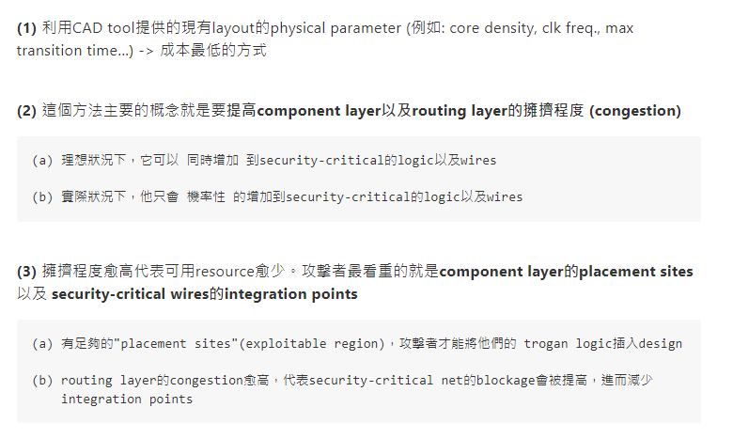
Two IC Defensive Approach : Undirected Defense

Slide 12
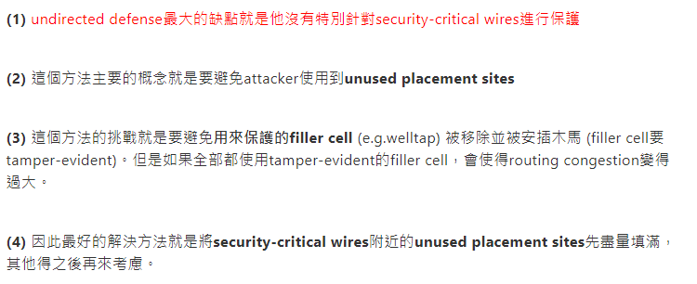
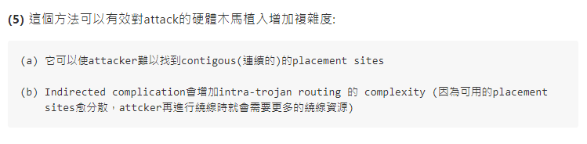
Two IC Defensive Approach : Directed Defense

Slide 13
Outline
Abstract
Background
Two IC Defensive Approach
ICAS Attack Step
ICAS Framework
Evaluation
Discussion
Conclusion

Slide 14
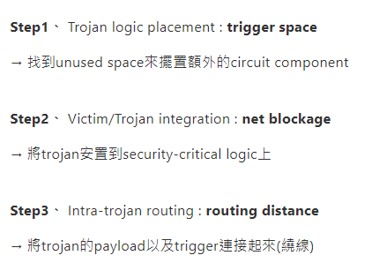
ICAS Attack Step

Slide 15
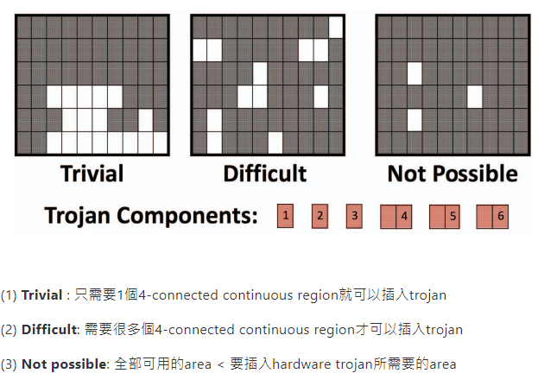
Challenge of Trojan Placement (ICAS’ Trigger Space Metric)

Slide 16
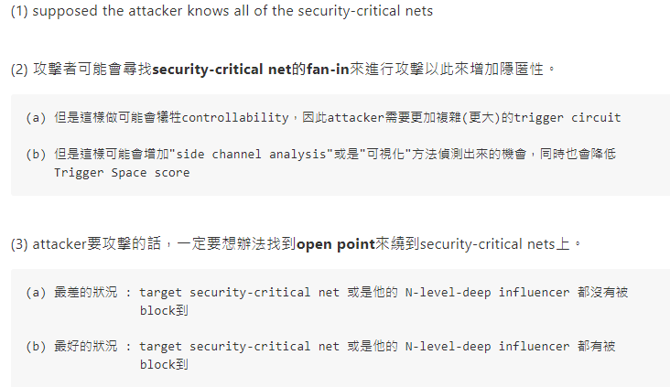
Challenge of Victim/Trojan Integration (ICAS’ Net Blockage Metric)
(1) supposed the attacker knows all of the security-critical nets
(1) supposed the attacker knows all of the security-critical nets
留言
(2) 攻擊者可能會尋找security-criticla net的fan-in來進行攻擊以此來增加隱匿性。
(a) 但是這樣做可能會犧牲controlability，因此attacker需要更加複雜(更大)的trigger circuit (b) 但是這樣可能會增加"side channel analysis"或是"可視化"方法偵測出來的機會，同時也會降低 Trigger Space score
(3) attacker要攻擊的話，一定要想辦法找到open point來繞到security-critical nets上。
(a) 最差的狀況 : target security-critical net 或是他的 N-level-deep influencer 都沒有被 block到 (b) 最好的狀況 : target security-critical net 或是他的 N-level-deep influencer 都有被 block到
留言
(2) 攻擊者可能會尋找security-criticla net的fan-in來進行攻擊以此來增加隱匿性。
(a) 但是這樣做可能會犧牲controlability，因此attacker需要更加複雜(更大)的trigger circuit (b) 但是這樣可能會增加"side channel analysis"或是"可視化"方法偵測出來的機會，同時也會降低 Trigger Space score
(3) attacker要攻擊的話，一定要想辦法找到open point來繞到security-critical nets上。
(a) 最差的狀況 : target security-critical net 或是他的 N-level-deep influencer 都沒有被 block到 (b) 最好的狀況 : target security-critical net 或是他的 N-level-deep influencer 都有被 block到

Slide 17
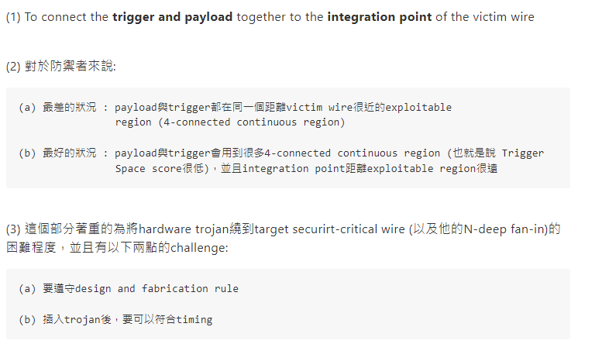
Challenge of Intra-Trojan Routing (ICAS’ Routing Distance Metric)

Slide 18
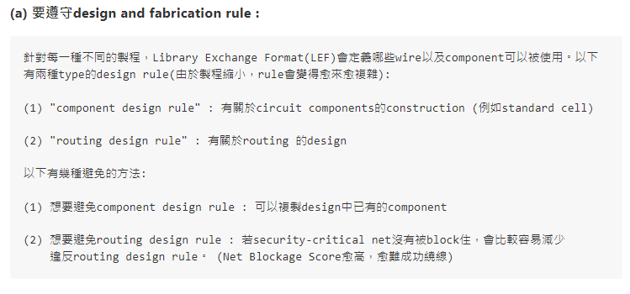
Challenge of Intra-Trojan Routing (ICAS’ Routing Distance Metric)

Slide 19
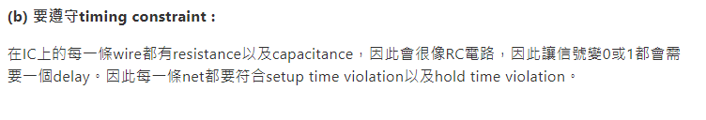
Challenge of Intra-Trojan Routing (ICAS’ Routing Distance Metric)

Slide 20
Outline
Abstract
Background
Two IC Defensive Approach
ICAS Attack Step
ICAS Framework
Evaluation
Discussion
Conclusion

Slide 21
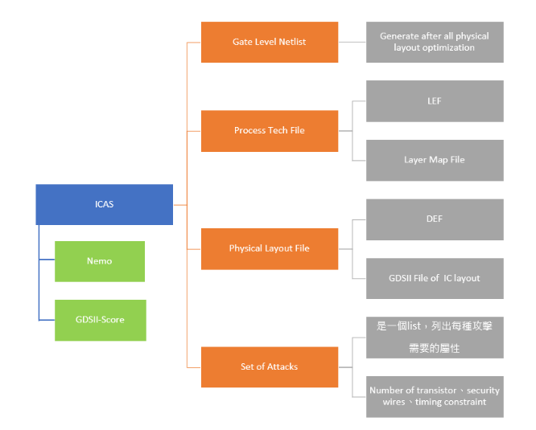
ICAS Framework

Slide 22
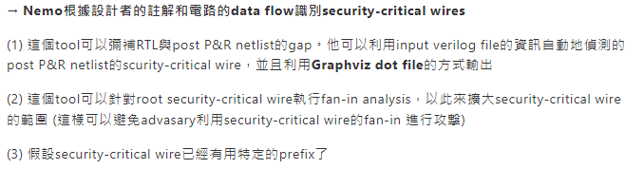
ICAS Framework : Nemo (Source)

Slide 23
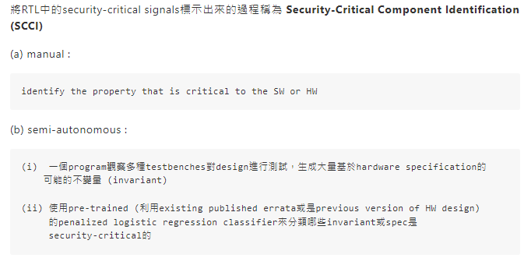
Nemo : Annotating Security-Critical Signals in the RTL Netlist

Slide 24
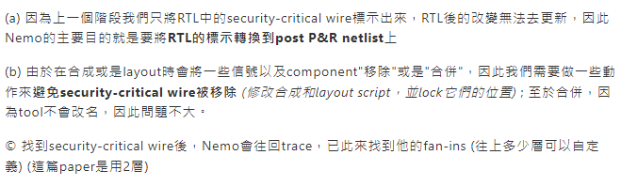
Nemo : 在P&R Netlist中分辨出哪些是Security-Critical Signals

Slide 25
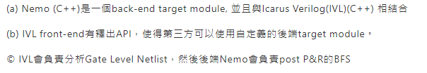
Nemo : Implementation

Slide 26
ICAS Framework : GDSII-Score (Source)
→ GDSII-Score是一個可以計算security metrics的extensible Python framework

Slide 27
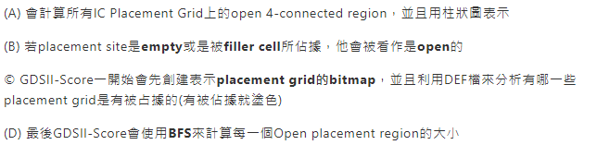
GDSII-Score : Trigger Space (Estimate the challenge of Trojan Placement)

Slide 28
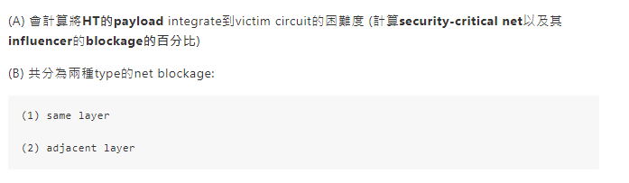
GDSII-Score : Net Blockage (考量將HT繞到open point的困難度)

Slide 29
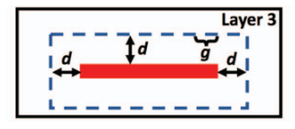
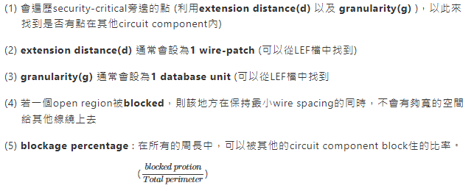
Net Blockage : Same Layer Blockage

Slide 30

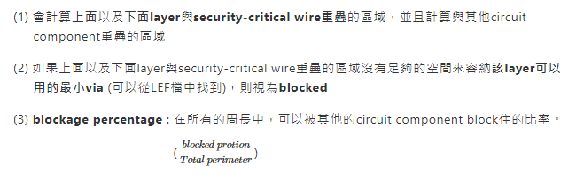
Net Blockage : Adjacent Layer

Slide 31
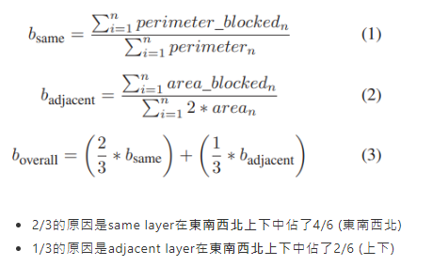
Net Blockage : Overall Net Blockage

Slide 32
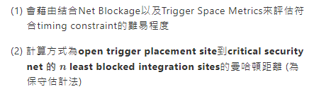
GDSII-Score : Routing Distance (考量讓HT符合timing constraint的困難度)

Slide 33
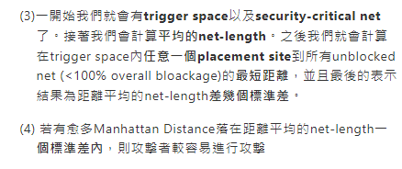
GDSII-Score : Routing Distance (考量讓HT符合timing constraint的困難度)

Slide 34
Outline
Abstract
Background
Two IC Defensive Approach
ICAS Attack Step
ICAS Framework
Evaluation
Discussion
Conclusion

Slide 35
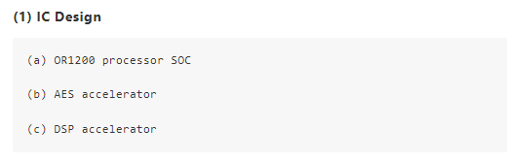
Evaluation : Experimental Setup

Slide 36
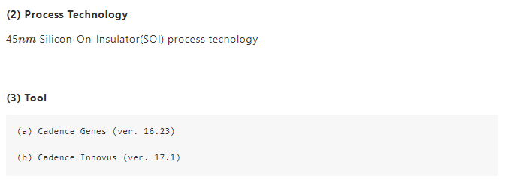
Evaluation : Experimental Setup

Slide 37
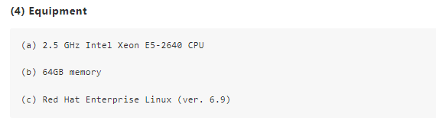
Evaluation : Experimental Setup

Slide 38
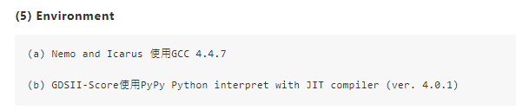
Evaluation : Experimental Setup

Slide 39
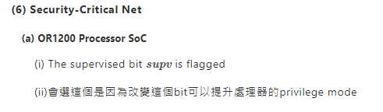
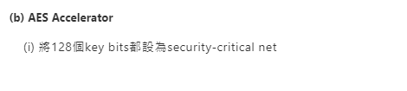
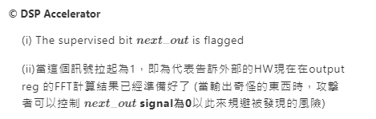
Evaluation : Experimental Setup

Slide 40
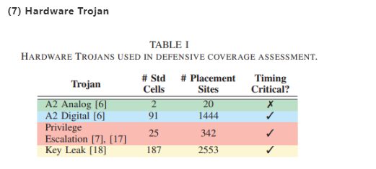
Evaluation : Experimental Setup

Slide 41
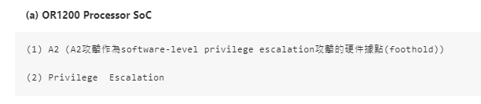

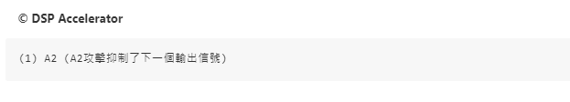
Evaluation : Experimental Setup

Slide 42
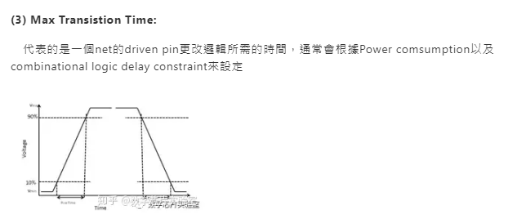
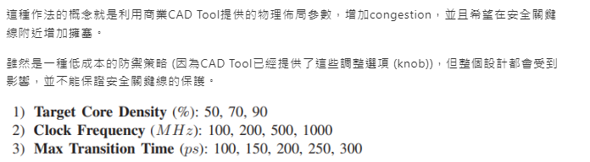


Evaluation : Undirected Defense Coverage

Slide 43
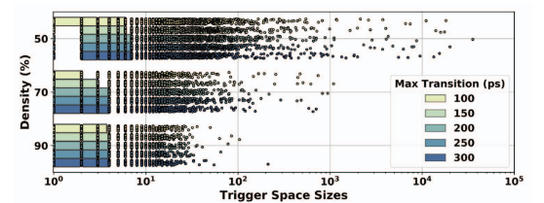
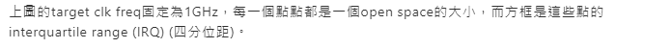
Undirected Defense : Trigger Space Analysis (15個不同的OR1200 layouts)
(a) core density愈高，open space會愈少
(b) 當密度較低時(50% or 70%)，max trans
time降低會有助於四分位距降低
(特大open space的機率降低)
(c) 同樣的，當clk freq.較低時，max trans
time降低會有助於四分位距降低

Slide 44
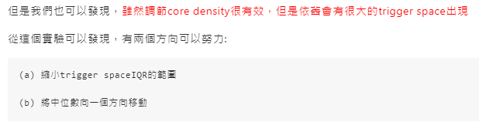
Undirected Defense : Trigger Space Analysis (15個不同的OR1200 layouts)

Slide 45
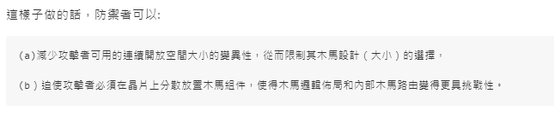
Undirected Defense : Trigger Space Analysis (15個不同的OR1200 layouts)

Slide 46
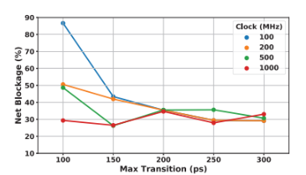

Undirected Defense : Net Blockage Analysis (20個不同的OR1200 layouts)
當clk freq很小時，當max trans time愈小，net blockage會愈大 (這樣代表只剩很少integration point給attacker去攻擊)
(b) 當clk freq變大時，max trans time與net
blockage的相關性會變差
Notes:
其中(b)的原因為當clk freq.變大時，driven pin上的capative load會變小，進而使得max trans constraint更容易滿足

Slide 47
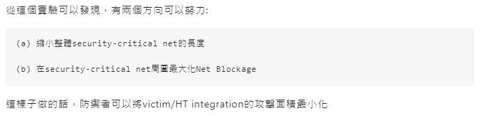
Undirected Defense : Net Blockage Analysis (20個不同的OR1200 layouts)
Notes:
其中(b)的原因為當clk freq.變大時，driven pin上的capative load會變小，進而使得max trans constraint更容易滿足

Slide 48
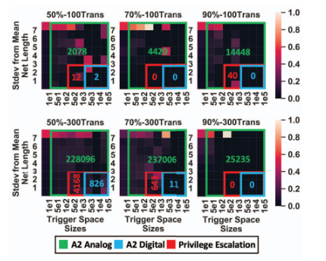

Undirected Defense : Routing Distance Analysis
那些（關鍵線路，觸發空間）配對的路由距離明顯大於IC佈局中的平均網絡長度，很可能不適合構建硬件木馬
(b) 具有熱度圖中更高比例的遠距離(關鍵線路
，觸發空間）配對且觸發空間較小的IC佈局
最為安全
(c) 在高密度情況下，max trans time對IC佈局的
安全性影響不大；而在較低密度情況下，較
小的max trans time設計更安全。
Notes:
這個圖是以column為一個單位，縱軸是距離平均net length差幾個標準差，橫軸則代表exploitable region的大小，而顏色則是代表在某一個exploitable region大小下，距離平均net length差幾個標準差的機率。
像是左上角的圖就是代表: 在exploitable region小於10的狀況下，與距離平均net length插7個標準差出現的機率大約是50%。 而一個column所有的機率相加會等於100%。
另外heatmap上的矩形為實現特定攻擊的區域以及可被利用的（安全關鍵線路，觸發空間）配對數量。

Slide 49
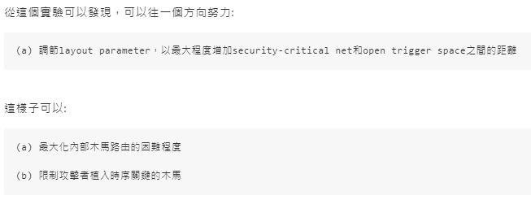
Undirected Defense : Routing Distance Analysis

Slide 50
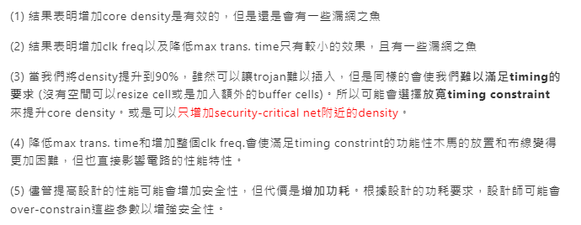
Undirected Defense : Cost Analysis

Slide 51
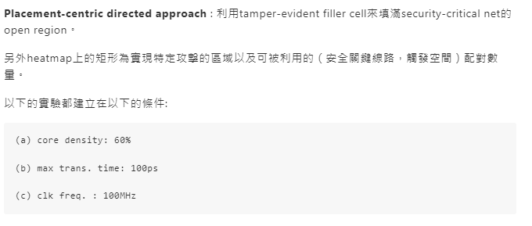
Evaluation : Directed Defense Coverage

Slide 52
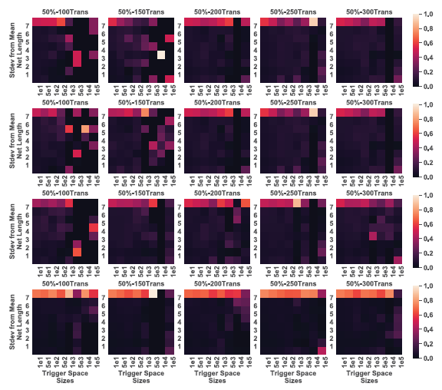

Slide 53
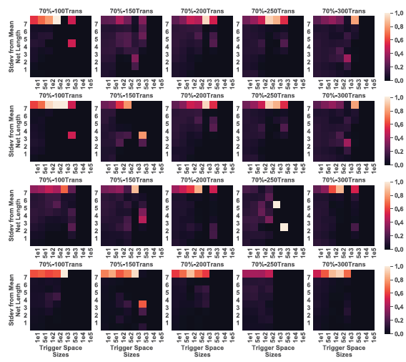

Slide 54
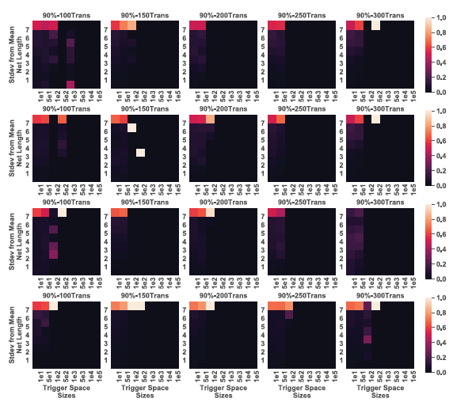

Slide 55
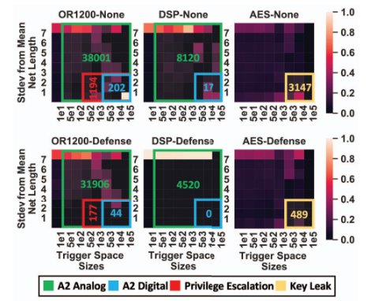
Directed Defense Coverage Analysis
若（安全關鍵線路，觸發空間）pair符合以下的情況，則稱為該pair可以作為HT插入的候選人:
(a) trigger space大小不小於所需的最小placement
sites數量
(b) security-critical net 沒有100%被blocked
(c) 若HT是timing critical (需要在design的
operation freq.下運作)，則觸發空間與安全關
鍵網路上的開放集成點之間的距離必須≤平均
net length的3個標準差; 反之則無限制

Slide 56
Outline
Abstract
Background
Two IC Defensive Approach
ICAS Attack Step
ICAS Framework
Evaluation
Discussion
Conclusion

Slide 57

Discussion

Slide 58

Discussion

Slide 59

Discussion

Slide 60

Discussion

Slide 61

Discussion

Slide 62
Outline
Abstract
Background
Two IC Defensive Approach
ICAS Attack Step
ICAS Framework
Evaluation
Discussion
Conclusion

Slide 63
Conclusion
(1) Nemo, a tool that bridges the semantic gap across IC design processes by tracking security-critical signals across all stages of hardware development
(2) GDSII-Score, a tool that estimates the difficulty a foundry-level attacker faces in attacking security-critical logic
(3) The experiments show that all current defenses leave the IC design vulnerable to attack—and some are totally ineffective
(4) ICAS can help designers identify and address defensive gaps.

Slide 64
Thanks For Listening!

